Slide 2
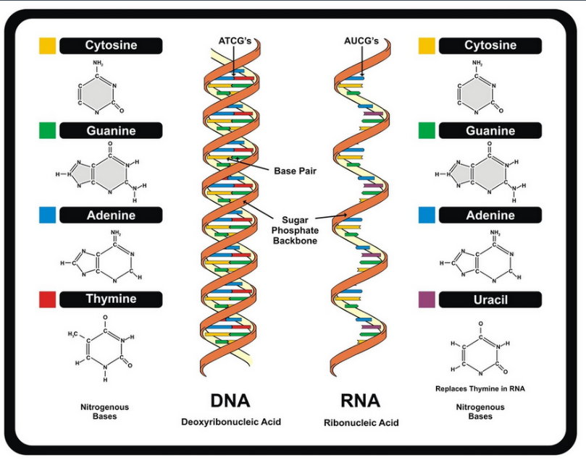
Structure of DNA/ RNA
Double helix
Consists of 4 base pairs
Sugar- Phosphate backbone
Colored blocks are the bases.
There are 2 strands of the backbone that runs in opposite direction
The bases on the 2 strands base pair

Slide 3
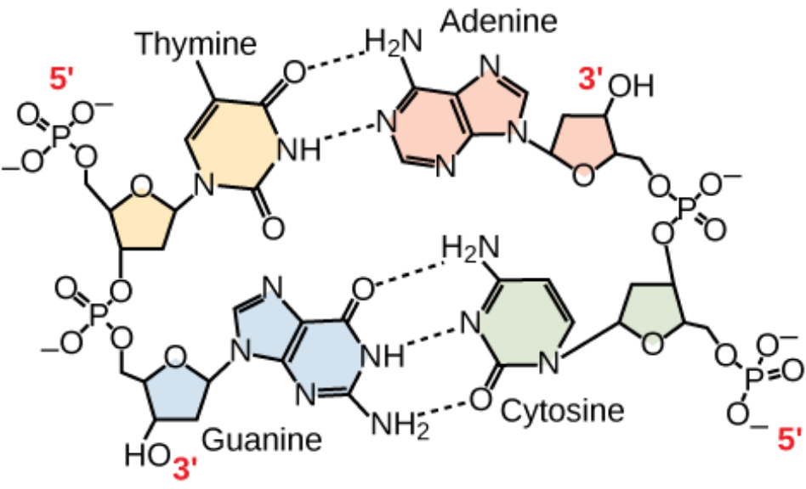
The rules pertaining to the basic DNA structure
There are 4 bases- Adenine [A], Guanine[G], Thymine [T], Cytosine [C].
A pairs with T [2 H-bonds]
G pairs with C [3 H-bonds]
Note!!!
The 2 strands are anti-parallel to each other.
Observe the sugar-Phosphate backbone to understand
------
Other terminologies- Complementary strands

Slide 4
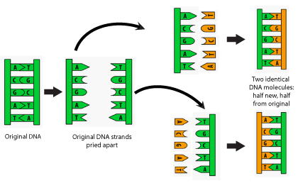
Replication- Making copies of DNA
Simple steps
Helicases- Unwinds DNA
Polymerases- Creates Complementary strand

Slide 5
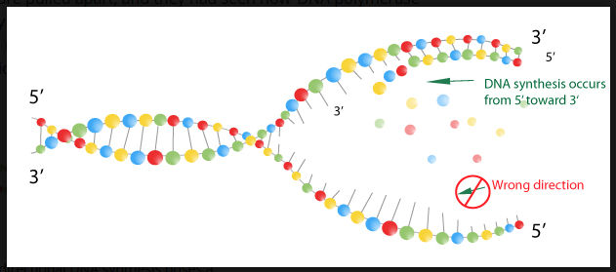
Replication – More details pertaining to directionality

Slide 6
DNA to mRNA
5’ TAC GCT GCT AGC TAG TCA 3’
3’ 5’ ??
3’ ATG CGA CGA TCG ATC AGT 5’
5’ UAC GCU GCU AGC UAG UCA 3’
5’ TAC GCT GCT AGC TAG TCA 3’
3’ ATG CGA CGA TCG ATC AGT 5’

Slide 7
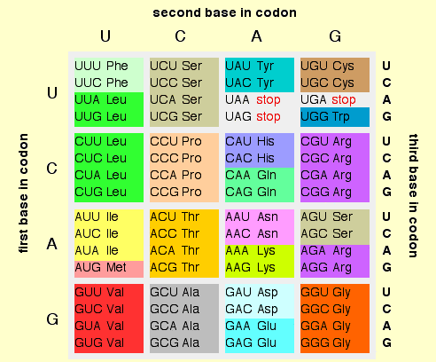
Triplet code/ mRNA to Protein code

Slide 8
Speed and Precision of DNA replication
Polymerase 700 bp per sec
Errors 1 in 10^7 nucleotides
With proof-reading 1 in 10^9 nucleotides

Slide 9
Types of mutations
Substitution- Exchanges one base for another
Insertion- Insertion of extra base pairs
Deletion- Deletion of a base pair or sections of DNA
Frame shift- Insertions or deletions resulting in altered proteins due to a shift in the frames.
There are other types but the above ones are the basic.

Slide 10
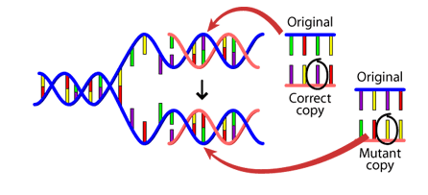

Causes of mutation
DNA fails to copy accurately
External influences can create mutations- harmful chemicals and radiation
Cell can repair- But is not perfect

Slide 11
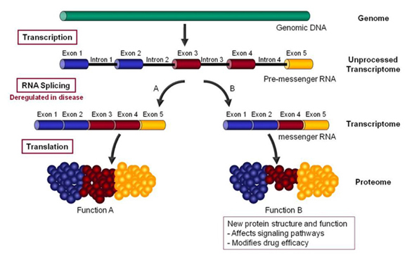
Hutchinson-Gilford Progeria Syndrome – a disease of accelerated aging due to Alternative Splicing
http://www.anti-agingfirewalls.com/2016/02/04/hutchinson-gilford-progeria-syndrome-a-disease-of-accelerated-aging-due-to-alternative-splicing/

Slide 12
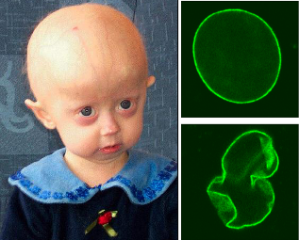
“HGPS is a major clue to solving the “puzzle of aging” and the molecular mechanisms here are relevant to normal aging. ”
https://en.wikipedia.org/wiki/Progeria

Slide 13
Genetic code/ Triplet code
There are 4 bases A,U,G, C
For a triplet code, how many combinations are possible?
Protein is made of 20 different amino acids

Slide 14
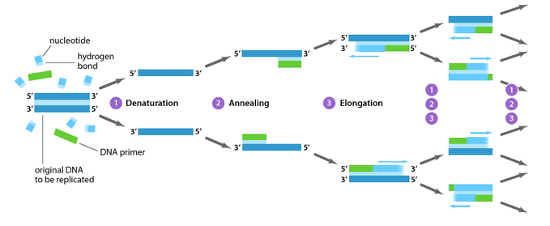
PCR-Polymerase Chain Reaction
https://www.youtube.com/watch?v=iQsu3Kz9NYo

Slide 15
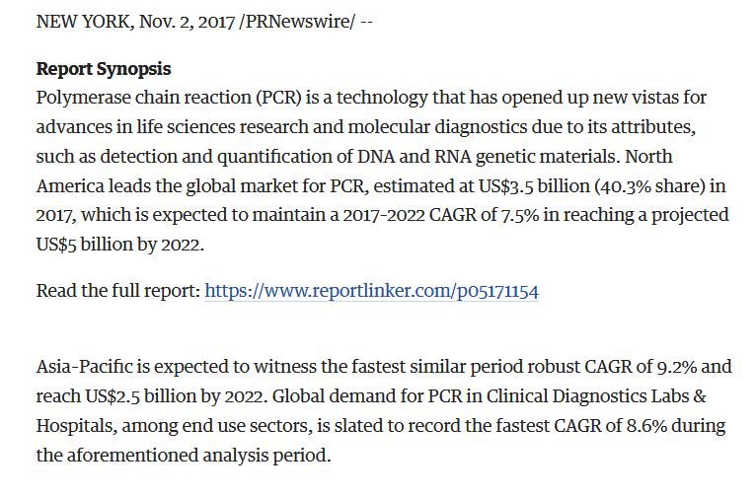
https://www.bizjournals.com/albany/prnewswire/press_releases/New_York/2017/11/02/SP34015
Notes:
15

